Slide 1
Web Programming
Presenter: Song Li

Slide 2
Why do we learn web programming?
A frontend for user interaction.
A backend for running your research project.
That is, a bridge connecting your potential users (who only know how to use a web browser) with your own research (maybe only you and your advisor know it).
A good marketing strategy to sell your research.

Slide 3
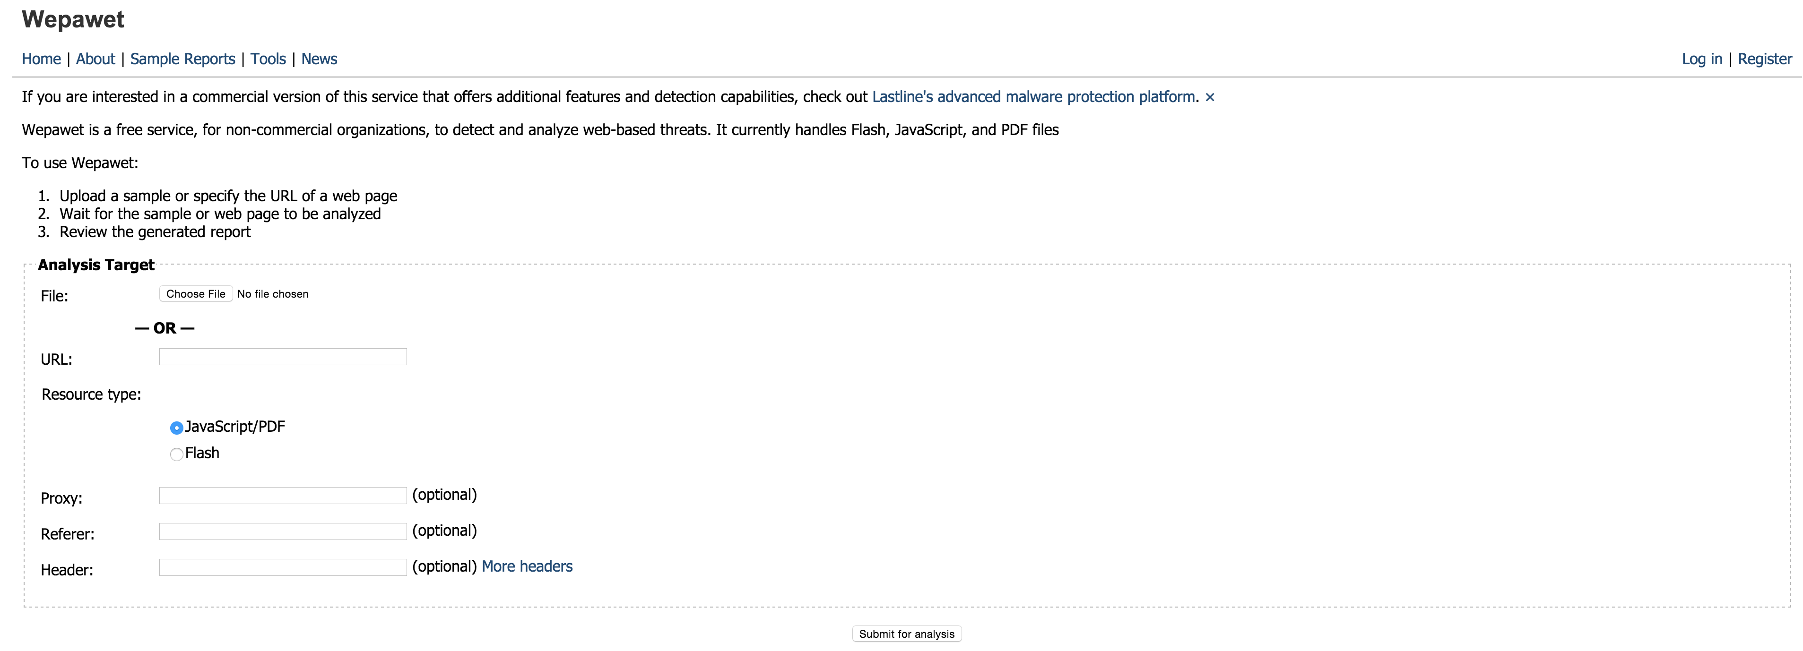
A Successful Example
https://wepawet.iseclab.org/

Slide 4
Roadmap
Web documents: HTML, CSS and DOM
Client-side programming: JavaScript, AJAX and Canvas
Server-side programming

Slide 5
HyperText Markup Language
Disagreement about HTML’s role
Only give the content and structure of the document, leave visualization to the browser
Browsers vary (graphical, text based, mobile devices)
User preferences vary (some people like larger fonts)
Environment varies (screen sizes, fonts available, etc.)
But authors want to control what the document looks like
Trend towards separating content from presentation
Cascading Style Sheets – presentation information only
HTML documents contain little formatting

Slide 6
Current state of the standards
In the 90s browser wars (IE vs. Netscape) were driving the evolution of HTML
Non-standard extensions used by pages lead to lock-in
W3C (World Wide Web Consortium) sets standards
Last HTML standard 5 (October 2014)
XHTML 2.0 XML-based format
XML (extensible markup language) – focuses on semantics and is used as general purpose format for structured data
A document called DTD or XML Schema defines what tags and attributes are allowed in an XML document

Slide 7
The <table></table> tag
Defines a table
The “border” attribute defines the width of the lines used to draw the table (in pixels)
Defaults to 0 which means no lines are drawn
The “width” attribute controls table width
By default it is in pixels
It can be given as a percentage of the window
If not specified, the table is only as wide as needed to display cell contents

Slide 8
The <tr></tr> tag
Defines a table row
The “align” attribute controls horizontal alignment of text in cells – can be “left”, “right”, “center”
The “valign” attribute controls vertical alignment of text in cells – can be “top”, “bottom”, “middle”
The “nowrap” attribute instructs the browser not to wrap the text from within the cells

Slide 9
The <td></td> tag
Defines a table cell
Has “align”, “valign” and “nowrap” attributes
“width” can be given as percentage of table width
“height” gives minimum height for cell
“colspan” allows a cell to span multiple columns
“rowspan” allows a cell to span multiple rows

Slide 10
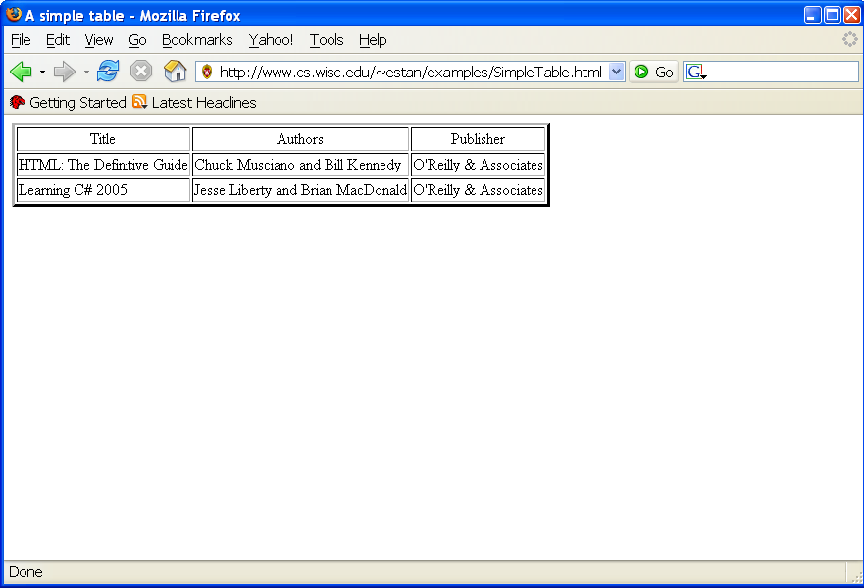
<table border="3">
<tr align="center"><td>Title</td>
<td>Authors</td>
<td>Publisher</td>
</tr>
<tr><td>HTML: The Definitive Guide</td>
<td>Chuck Musciano and Bill Kennedy</td>
<td>O'Reilly &amp; Associates</td>
</tr>
<tr><td>Learning C# 2005</td>
<td>Jesse Liberty and Brian MacDonald</td>
<td>O'Reilly &amp; Associates</td>
</tr>
</table>

Slide 11
The <form></form> tag
<form action="action_page.php"> <fieldset> <legend>Personal information:</legend> First name:<br> <input type="text" name="firstname" value="Mickey"> <br> Last name:<br> <input type="text" name="lastname" value="Mouse"> <br><br> <input type="submit" value="Submit"> </fieldset> </form>

Slide 12
The <form></form> tag

Slide 13
Style Sheet Languages
Cascading Style Sheets (CSS)
Applies to (X)HTML as well as XML documents in general
Covered in this slide
Extensible Stylesheet Language (XSL)
Often used to transform one XML document to another form, but can also add style
XSL Transformations not covered in this slide

Slide 14
CSS Introduction
link element associates style sheet with doc.

Slide 15
CSS Introduction
type attribute specifies style language used

Slide 16
CSS Introduction
href attribute provides style sheet URL

Slide 17
CSS Introduction
title attribute provides style sheet name

Slide 18
CSS Introduction
Single document can be displayed on multiple media platforms by tailoring style sheets:
This document will be printed differently than it is displayed.

Slide 19
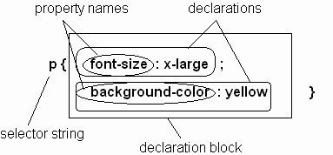
CSS Syntax
Parts of a style rule (or statement)

Slide 20
CSS Syntax: Selector Strings
Single element type:
Multiple element types:
All element types:
Specific elements by id:

Slide 21
CSS Syntax: Selector Strings
Elements belonging to a style class:
Referencing a style class in HTML:
Elements of a certain type and class:
class selector: begins with a period .

Slide 22
CSS Syntax: Selector Strings
Elements belonging to a style class:
Referencing a style class in HTML:
Elements of a certain type and class:
this span belongs to three style classes

Slide 23
CSS Syntax: Selector Strings
Elements belonging to a style class:
Referencing a style class in HTML:
Elements of a certain type and class:
this rule applies only to span’s belonging to class special

Slide 24
CSS Syntax: Selector Strings
Source anchor elements:
Element types that are descendents:
pseudo-classes

Slide 25
CSS Syntax: Selector Strings
Source anchor elements:
Element types that are descendants:
rule applies to li element that is

Slide 26
CSS Syntax: Selector Strings
Source anchor elements:
Element types that are descendants:
rule applies to li element that is
part of the content of an ol element

Slide 27
CSS Syntax: Selector Strings
Source anchor elements:
Element types that are descendants:
rule applies to li element that is
part of the content of an ol element
that is part of the content of a ul element

Slide 28
CSS Syntax
Style rules covered thus far follow ruleset syntax
At-rule is a second type of rule
Reads style rules from specified URL
Must appear at beginning of style sheet
URL relative to style sheet URL

Slide 29
CSS Rule Cascade
To find the value for an element/property combination, user agents must apply the following sorting order:
1- Find all declarations that apply to the element and property in question, for the target media type. Declarations apply if the associated selector matches the element in question.

Slide 30
CSS Rule Cascade
2- The primary sort of the declarations is by weight and origin: for normal declarations, author style sheets override user style sheets which override the default style sheet. For "!important" declarations, user style sheets override author style sheets which override the default style sheet. "!important" declaration override normal declarations. An imported style sheet has the same origin as the style sheet that imported it.
Five origin/weight levels:
user/important
author/important
author/normal
user/normal
user agent/normal

Slide 31
CSS Rule Cascade
3- The secondary sort is by specificity of selector: more specific selectors will override more general ones. Pseudo-elements and pseudo-classes are counted as normal elements and classes, respectively.
Specificity:
style attribute
rule with selector:
ID
class/pseudo-class
descendant/element type
universal
HTML attribute

Slide 32
CSS Rule Cascade
4- Finally, sort by order specified: if two rules have the same weight, origin and specificity, the latter specified wins. Rules in imported style sheets are considered to be before any rules in the style sheet itself.
Conceptually, create one
long style sheet. Later
style rules have higher
priority than earlier rules.

Slide 33
CSS Inheritance
What if no style declaration applies to a property of an element?
Generally, the property value is inherited from the nearest ancestor element that has a value for the property
If no ancestor has a value (or the property does not inherit) then CSS defines an initial value that is used

Slide 34
CSS Properties
Fonts
CSS Box Model

Slide 35
Document Object Model (DOM)
<html>
<head>
<title>A Document</title>
</head>
<body>
<h1>A web page</h1>
<p>A <i>simple</i> paragraph</p>
</body>
</html>
document
<html>
<head>
<body>
<title>
<h1>
“A document”
“A web page”
<p>
“A ”
<i>
“ paragraph”
“simple”

Slide 36
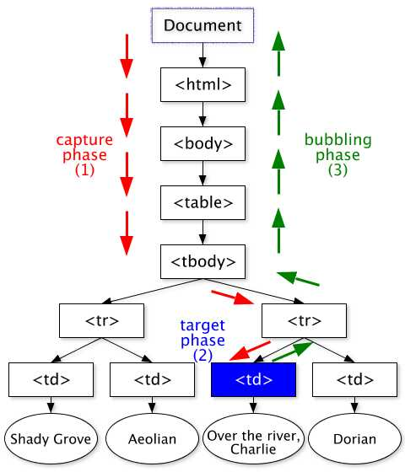
DOM Events
Events can be
User actions: OnClick, OnMouseover
Rendering: OnLoad, OnBeforeUnload
Timing: setTimeout(), clearTimeout()

Slide 37
JavaScript
How to include?
<script src=“a.js”></script>
For example, we want to define Functions
function myFunction(p1, p2) { return p1 * p2; // The function returns the product of p1 and p2 }
var adder = new Function('a', 'b', 'return a + b');

Slide 38
Some Interesting Properties of JavaScript
Prototype
var myObject = function(name){
this.name = name;
return this;
};
myObject.prototype.getName = function(){ return “abc”;
};
my = new myObject;
my.getName();

Slide 39
Prototype
Every Object has a __proto__ property.
Once an property is not found in a certain object, the JavaScript engine will look up the __proto__ chain to find the property.
In the example,
my.__proto__ == myObject.prototype
my.getName();
The root node in __proto__ chain is Object
my.__proto__.__proto__ == Object
prototype is used to create __proto__, when new is called on a function.

Slide 40
Some Interesting Properties of JavaScript
getter & setter Function
var person = {
firstName: 'Jimmy',
lastName: 'Smith',
get fullName() {
return this.firstName + ' ' + this.lastName;
},
set fullName (name) {
var words = name.toString().split(' ');
this.firstName = words[0] || '';
this.lastName = words[1] || '';
}
}
person.fullName = 'Jack Franklin';
console.log(person.firstName); // Jack
console.log(person.lastName) // Franklin

Slide 41
AJAX
AJAX is not a programming language/technology.
Ajax is a design approach and a set of techniques for creating a highly interactive user experience for web applications.
Makes Applications faster and user friendly.

Slide 42
Real-Life Examples of AJAX
Google Maps
- http://maps.google.com/
Google Suggest
- http://www.google.com/
Gmail
- http://gmail.com/

Slide 43
AJAX Basics
AJAX uses XMLHttpRequest
JavaScript communicates directly with the server, through the JavaScript XMLHttpRequest object .
With an XMLHTTPRequest, a web page can make a request to, and get a response from a web server - without reloading the page.

Slide 44
A New Way of Building Applications
AJAX Applications Are:
3-tier client/server apps
Browser ↔ App Server ↔ Data Source
Event driven
User clicks, user drags, user changes data
Graphics Intensive
Visual Effects, Rich Visual Controls
Are Data Oriented
Users are manipulating and entering data
Are Complex
Pages hold many more controls and data than page-oriented applications
Multiple Master-Detail Relationships in one page

Slide 45
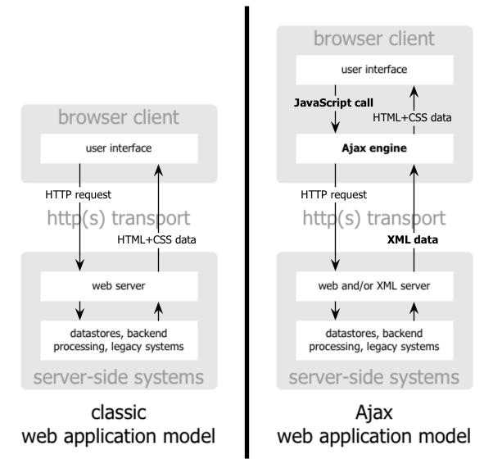
Classic vs AJAX
Notes:
Instead of the traditional web application model where the browser itself is responsible for initiating requests to, and processing requests from, the web server, the Ajax model provides an intermediate layer — what Garrett calls an Ajax engine — to handle this communication. An Ajax engine is really just a JavaScript object or function that is called whenever information needs to be requested from the server. Instead of the traditional model of providing a link to another resource (such as another web page), each link makes a call to the Ajax engine, which schedules and executes the request. The request is done asynchronously, meaning that code execution doesn't wait for a response before continuing.

Slide 46
AJAX Terminology
onreadystatechange
readyState
status
responseText
responseXML
Notes:
•onreadystatechange: It contains the name of a function to be called automatically whenever the readyState property changes
•readyState: It includes the status of the XMLHttpRequest and it changes from 0 to 4:
•status: status 200 means "OK" and status 404 means "Page not found".
•responseText: If the response from the server is not in XML format, use the responseText property. The responseText property returns
the response as a string, and you can use it accordingly.
•responseXML: If the response from the server is XML format, and you want to parse it as an XML object, use this property.

Slide 47
How AJAX works ?
JavaScript
– Define an object for sending XMLHTTP requests
– Initiate request
• Get request object
• Designate a request handler function
– Supply as onreadystatechange attribute of request
• Initiate a GET or POST request
• Send data
– Handle response
• Wait for readyState of 4 and HTTP status of 200
• Extract return text with response Text or responseXML
• Do something with result
HTML
– Loads JavaScript
– Gives ids to input elements that will be read by script

Slide 48
Define Object
var request;
function getRequestObject()
{
if (window.ActiveXObject) { //IE5, IE6
return(new ActiveXObject("Microsoft.XMLHTTP"));
} else if (window.XMLHttpRequest) {//IE7+, Firefox,…
return(new XMLHttpRequest());
} else {
return(null);
}
}

Slide 49
Initiate Request
function sendRequest() {
request = getRequestObject();
request.onreadystatechange = handleResponse;
request.open("GET", "message-data.html", true);
request.send(null);
}

Slide 50
Handling Response
function handleResponse()
{
if (request.readyState == 4 && request. status == 200) {
alert(request.responseText);
}
}

Slide 51
AJAX ready states
0 - Uninitialized
1 - Loading
2 - Loaded
3 - Processing
4 - Request Finished
AJAX status
200 - ok
404 – Page Not Found

Slide 52
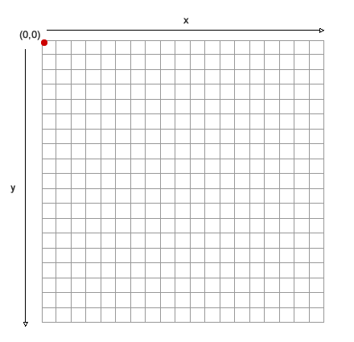
HTML5 Canvas
THE GRID

Slide 53
SET-UP FOR DRAWING
grab the canvas element
var mycanvas = document.getElementById("the_canvas");
var context = mycanvas.getContext("2d");
set up a 2D context
Notes:
1canvas-base.html

Slide 54
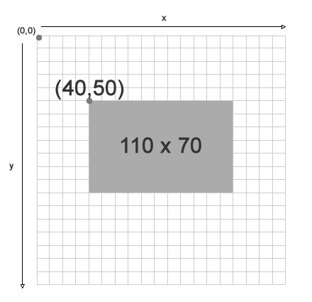
DRAWING A RECTANGLE
context.fillStyle = "rgba(0, 204, 204, 1)";
context.fillRect(40,50,110,70);

Slide 55

DRAWING LINES
context.beginPath(); //set up to draw a path
context.moveTo(x,y); //move to the start position
context.lineTo(x,y); //set the end pointcontext.stroke(); //draw the line
3. Draw line between points
1. Set start position
2. Set end position
Notes:
2canvas-lineclick.html The code example uses a mouse listener

Slide 56
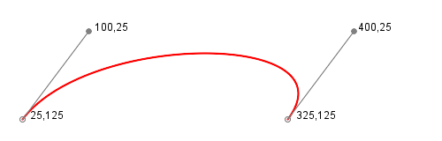
DRAWING CURVES
Control point 1
bezierCurveTo(100,25 ...
Control point 2
...400,25...
Start point
MoveTo(25,125)
Destination point
...325,125);
Notes:
3canvas-bezier.html

Slide 57
CODING CURVES
var controlPt1 = {x:110,y:30};
var controlPt2 = {x:130,y:80};
var startPt = {x:75,y:140};
ctx.beginPath(); //prepare path
ctx.moveTo(startPt.x,startPt.y);
ctx.bezierCurveTo(
controlPt1.x,controlPt1.y,
controlPt2.x,controlPt2.y,
startPt.x,startPt.y
);
ctx.stroke();

Slide 58
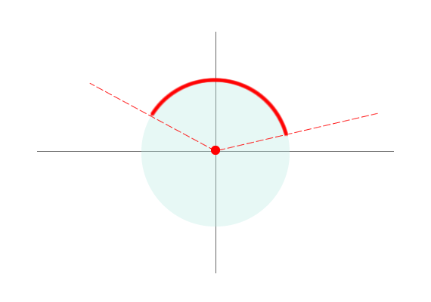
DRAWING ARCS
1.5 * PI
Start angle
PI
0
Center point
End angle
0.5 * PI

Slide 59
DRAWING ARCS & CIRCLES
Circles are types of arcs
Angles are in radians (need to calculate between degrees and radians)
ctx.beginPath();ctx.arc(x, y, radius, 0, Math.PI*2, true);ctx.closePath();ctx.fill();
Start angle
End angle
Notes:
radians = degrees * (pi/180)
last parameter (bool) is anticlockwise
Circle example in canvas-keyboard.html - also keyboard listener example
Circle in: canvas-bounce.html

Slide 60
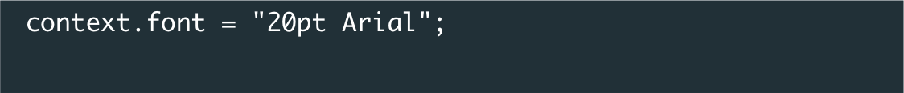
TEXT
Text is "drawn" to the canvas
context.fillText("Hello world", 10, 50);
Style text in CSS syntax with .font property
Get the dimensions of a text area
textObj = ctx.measureText(d);
width = textObj.width;
Notes:
The foursqare example uses text

Slide 61
TRANSFORMATIONS
To change the orientation of one element on the canvas, you must shift the entire canvas
Translate: move the canvas and its origin to a different point in the grid
Rotate: rotate the canvas around the current origin

Slide 62
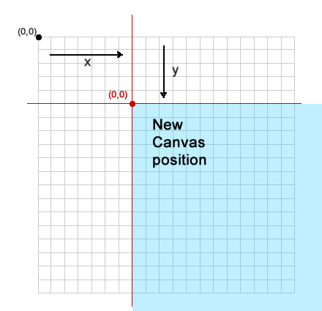
TRANSLATE CONTEXT
Context moved.
The origin point now has a new location.

Slide 63
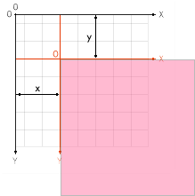
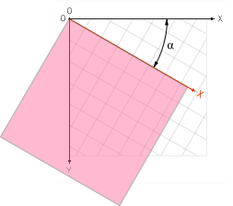
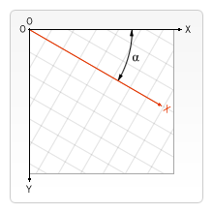
TRANSLATE & ROTATE
Translate
translate(x, y)
Rotate
rotate(angle)

Slide 64
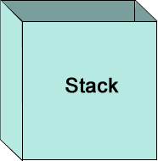
THE STATE STACK
State 1Fill Style: redRotation: 45deg
State 2
State 1
save()
State 2Fill Style: blackLine Style: blue
Scale: 50%
restore()
Notes:
build slide?

Slide 65
SAVE & RESTORE
ctx.fillRect(0,0,150,150); //Draw with default settings ctx.save(); // Save the default state ctx.fillStyle = '#09F'; //Change the fill color ctx.fillRect(15,15,120,120); // Draw with new settings
ctx.save(); //Save the current state
ctx.fillStyle = '#FFF'; //Change fill again ctx.fillRect(15,15,120,120); // Draw with new settings
ctx.restore(); //Restore to last saved state
ctx.fillRect(45,45,60,60); //Draw with restored settings
state 1
state 2
back to state 2
Notes:
Translate code is used in canvas-dogrun.html
Also in the foursquare example, used to rotate text

Slide 66
DRAW IMAGE
var img = new Image(); //Create an image objectimg.src = 'dog.png'; //Set source
img.onload = function(){ //Wait for the image to load
context.drawImage(img,x,y); //Draw image to canvas
}
Notes:
canvas-dogrun.html

Slide 67
REDRAW IMAGE
//clear the stage
clearRect(0,0,canvas.width,canvas.height);
speed = 10;
if (previous_x < mouse_x){
direction = 1; //moving left to right
} else {
direction = -1; //moving right to left
}
var new_x = previous_x + (speed * direction);
context.drawImage(img,new_x,y);

Slide 68
Canvas Events

Slide 69
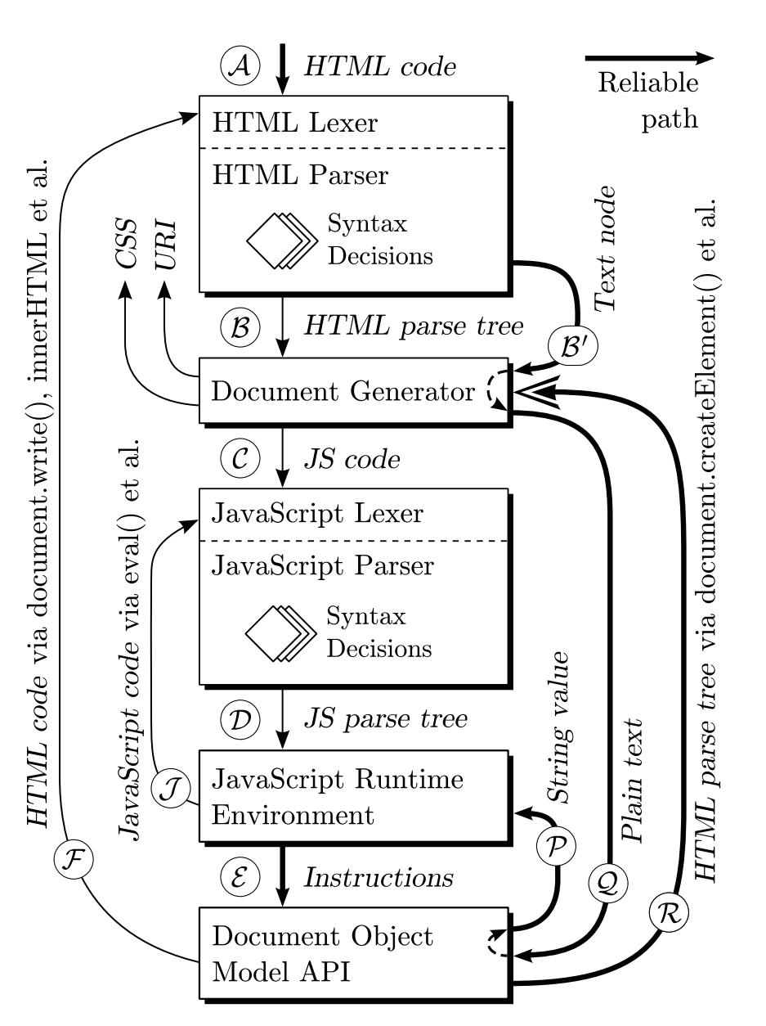

Slide 70
Server-side Programming
Python BaseHTTPServer
import BaseHTTPServer
htmlpage = """ <html><head><title>Web Page</title></head> <body>Hello Python World</body> </html>"""
notfound = "File not found"
class WelcomeHandler(BaseHTTPServer.BaseHTTPRequestHandler):
def do_GET(self):
if self.path == "/":
self.send_response(200)
self.send_header("Content-type","text/html")
self.end_headers()
self.wfile.write(htmlpage)
else:
self.send_error(404, notfound)
httpserver = BaseHTTPServer.HTTPServer(("",80), WelcomeHandler)
httpserver.serve_forever()

Slide 71
LAB: Drawing a star

Slide 72
variables (in script element)
var ctx;
var pts=[
//5 points for star: rough drawing
[100,35],
[60,10],
[20,35],
[35,100],
[85,100]
];
var colors=["red","white","blue"];
//used in succession
var c=0; // points to next color

Slide 73
variables (in script element)
var ctx;
var pts=[ //5 points for star: rough drawing
[100,35],
[60,10],
[20,35],
[35,100],
[85,100]
];
var colors=["red","white","blue"];
//used in succession
var c=0; // points to next color

Slide 74
variables (in script element)
var ctx;
var pts=[ //5 points for star: rough drawing
[100,35],
[60,10],
[20,35],
[35,100],
[85,100]
];
var colors=["red","white","blue"];
//used in succession
var c=0; // points to next color

Slide 75
variables (in script element)
var ctx;
var pts=[ //5 points for star: rough drawing
[100,35],
[60,10],
[20,35],
[35,100],
[85,100]
];
var colors=["red","white","blue"];
//used in succession
var c=0; // points to next color

Slide 76
variables (in script element)
var ctx;
var pts=[ //5 points for star: rough drawing
[100,35],
[60,10],
[20,35],
[35,100],
[85,100]
];
var colors=["red","white","blue"];
//used in succession
var c=0; // points to next color

Slide 77
function init() {
ctx =
document.getElementById('canvas').getContext('2d'); }
function makestar() {
ctx.clearRect(0,0,600,400);
ctx.fillStyle=colors[c];
c = c +1;
// can reduce to one line using colors[c++]
c = (c<3)?c:0;
ctx.beginPath();
ctx.moveTo(pts[0][0],pts[0][1]);
ctx.lineTo(pts[3][0],pts[3][1]);
ctx.lineTo(pts[1][0],pts[1][1]);
ctx.lineTo(pts[4][0],pts[4][1]);
ctx.lineTo(pts[2][0],pts[2][1]);
ctx.lineTo(pts[0][0],pts[0][1]);
ctx.stroke();
//outline (necessary for white star!
ctx.fill(); }

